Slide 1


INNOVATION AND SELf DRIVING CARS

Slide 2

Driverless Cars : Innovation paves the road to opportunities
Disruptive technologies and trends are reshaping the landscape across sectors
Computer Science and technology are enabling the creation of product and services that previously existed in the realm of science fiction.
One such Game changing innovation is : Autonomous Driving Technology

Slide 3
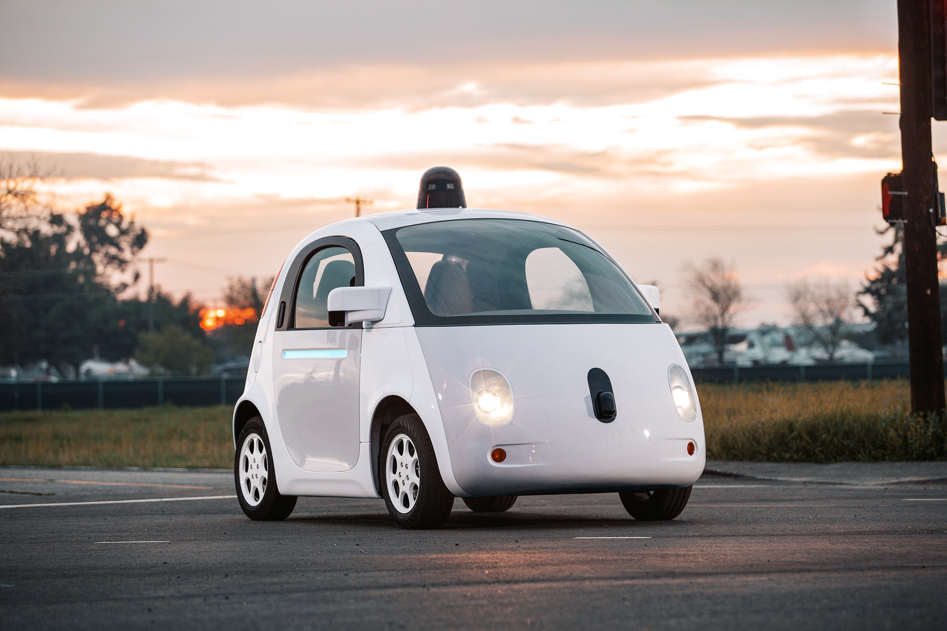
Google’s Self Driving Car Project - Waymo

Slide 4


Slide 5
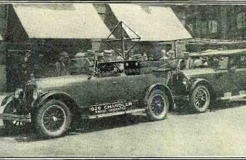
History OF Self – Driving Cars
THE DRIVERLESS DREAM BEGINS
1925 - Francis Houdina demonstrates a radio-controlled car which can start its engine, shift gears, and sound its horn, “as if a phantom hand were at the wheel.”

Slide 6
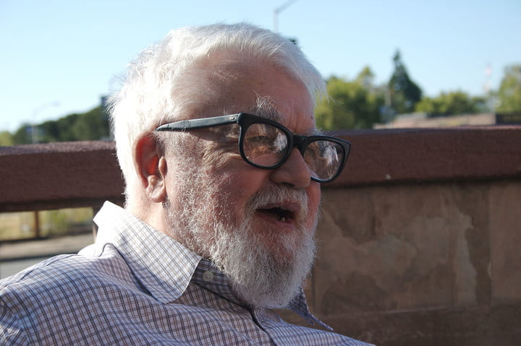
History OF Self – Driving Cars
JOHN MCCARTHY’S ROBO-CHAUFFEUR
1969 - John McCarthy describes something similar to the modern autonomous vehicle in an essay titled “Computer-Controlled Cars.” McCarthy refers to an “automatic chauffeur,” capable of navigating a public road via a “television camera input that uses the same visual input available to the human driver.”

Slide 7
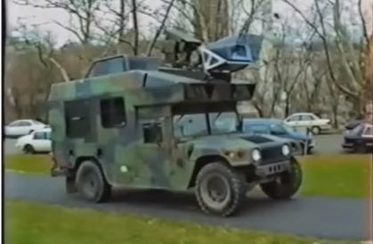
History OF Self – Driving Cars
NO HANDS ACROSS AMERICA
1995 - Pomerleau and Todd Jochem take their Navlab self-driving car system on the road. Their bare bones autonomous minivan (they have to control speed and braking) travels 2,797 miles coast-to-coast from Pittsburgh, Pennsylvania to San Diego, California in a journey the pair dubs “No Hands Across America.”

Slide 8
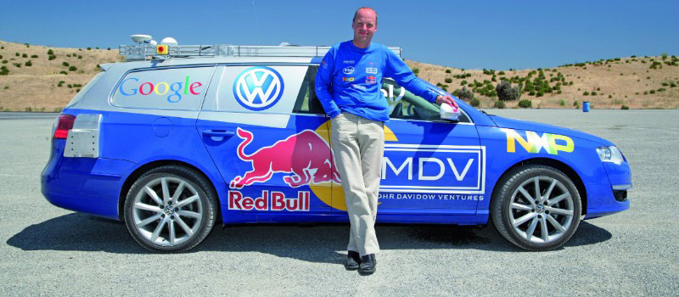
History OF Self – Driving Cars
THE GRAND CHALLENGE IS TOO CHALLENGING
2002 - DARPA announces its Grand Challenge, offering researchers from top research institutions a $1 million prize if they can build an autonomous vehicle able to navigate 142 miles through the Mojave Desert.

Slide 9
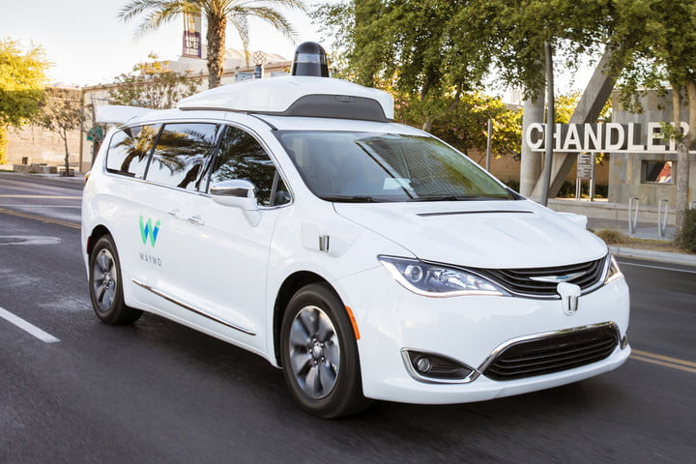
History OF Self – Driving Cars
GOOGLE SEARCHES FOR AN ANSWER
2009 - Google begins developing its self-driving car project, now called Waymo, in secret. The project is initially led by Sebastian Thrun, the former director of the Stanford Artificial Intelligence Laboratory and co-inventor of Google Street View.

Slide 10
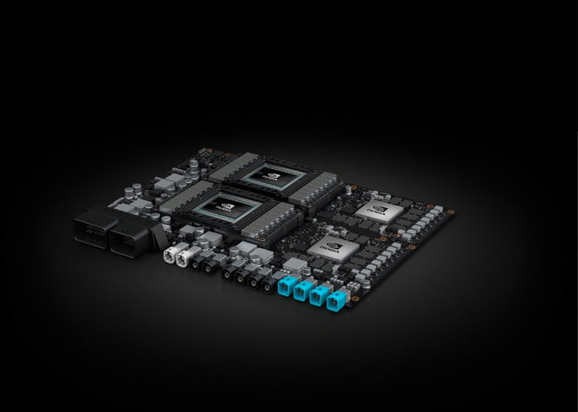
History OF Self – Driving Cars
AI COMES TO SELF-DRIVING CARS
2018 - Nvidia unveiled a new self-driving car chip called Xavier that will incorporate artificial-intelligence capabilities. The company then announced that it was partnering with Volkswagen to develop AI for future self-driving cars.

Slide 11
Are we there yet ????
2030 – 15% of Passenger vehicles sold worldwide
2040 – 80%

Slide 12
Autonomy LEVELS
Level 0
Level 1
Level 2
Level 3
Level 4
Level 5
No automation
Limited driver assistance
Driver-assist systems
Autonomous mode in certain situations
autonomous mode most of the times
Fully autonomous

Slide 13
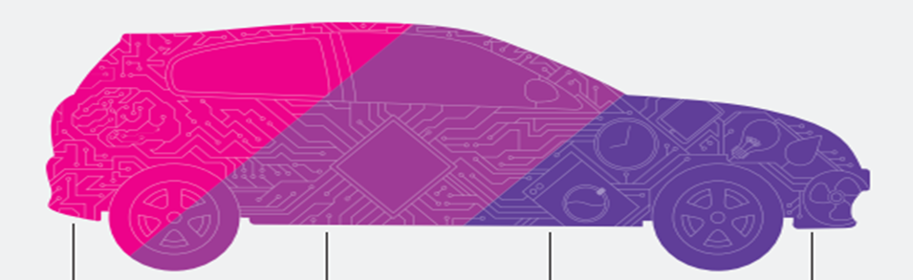
WHAT MAKES DRIVERLESS CARS POSSIBLE ?
Sensors
Processors
Artificial Intelligence
Control

Slide 14
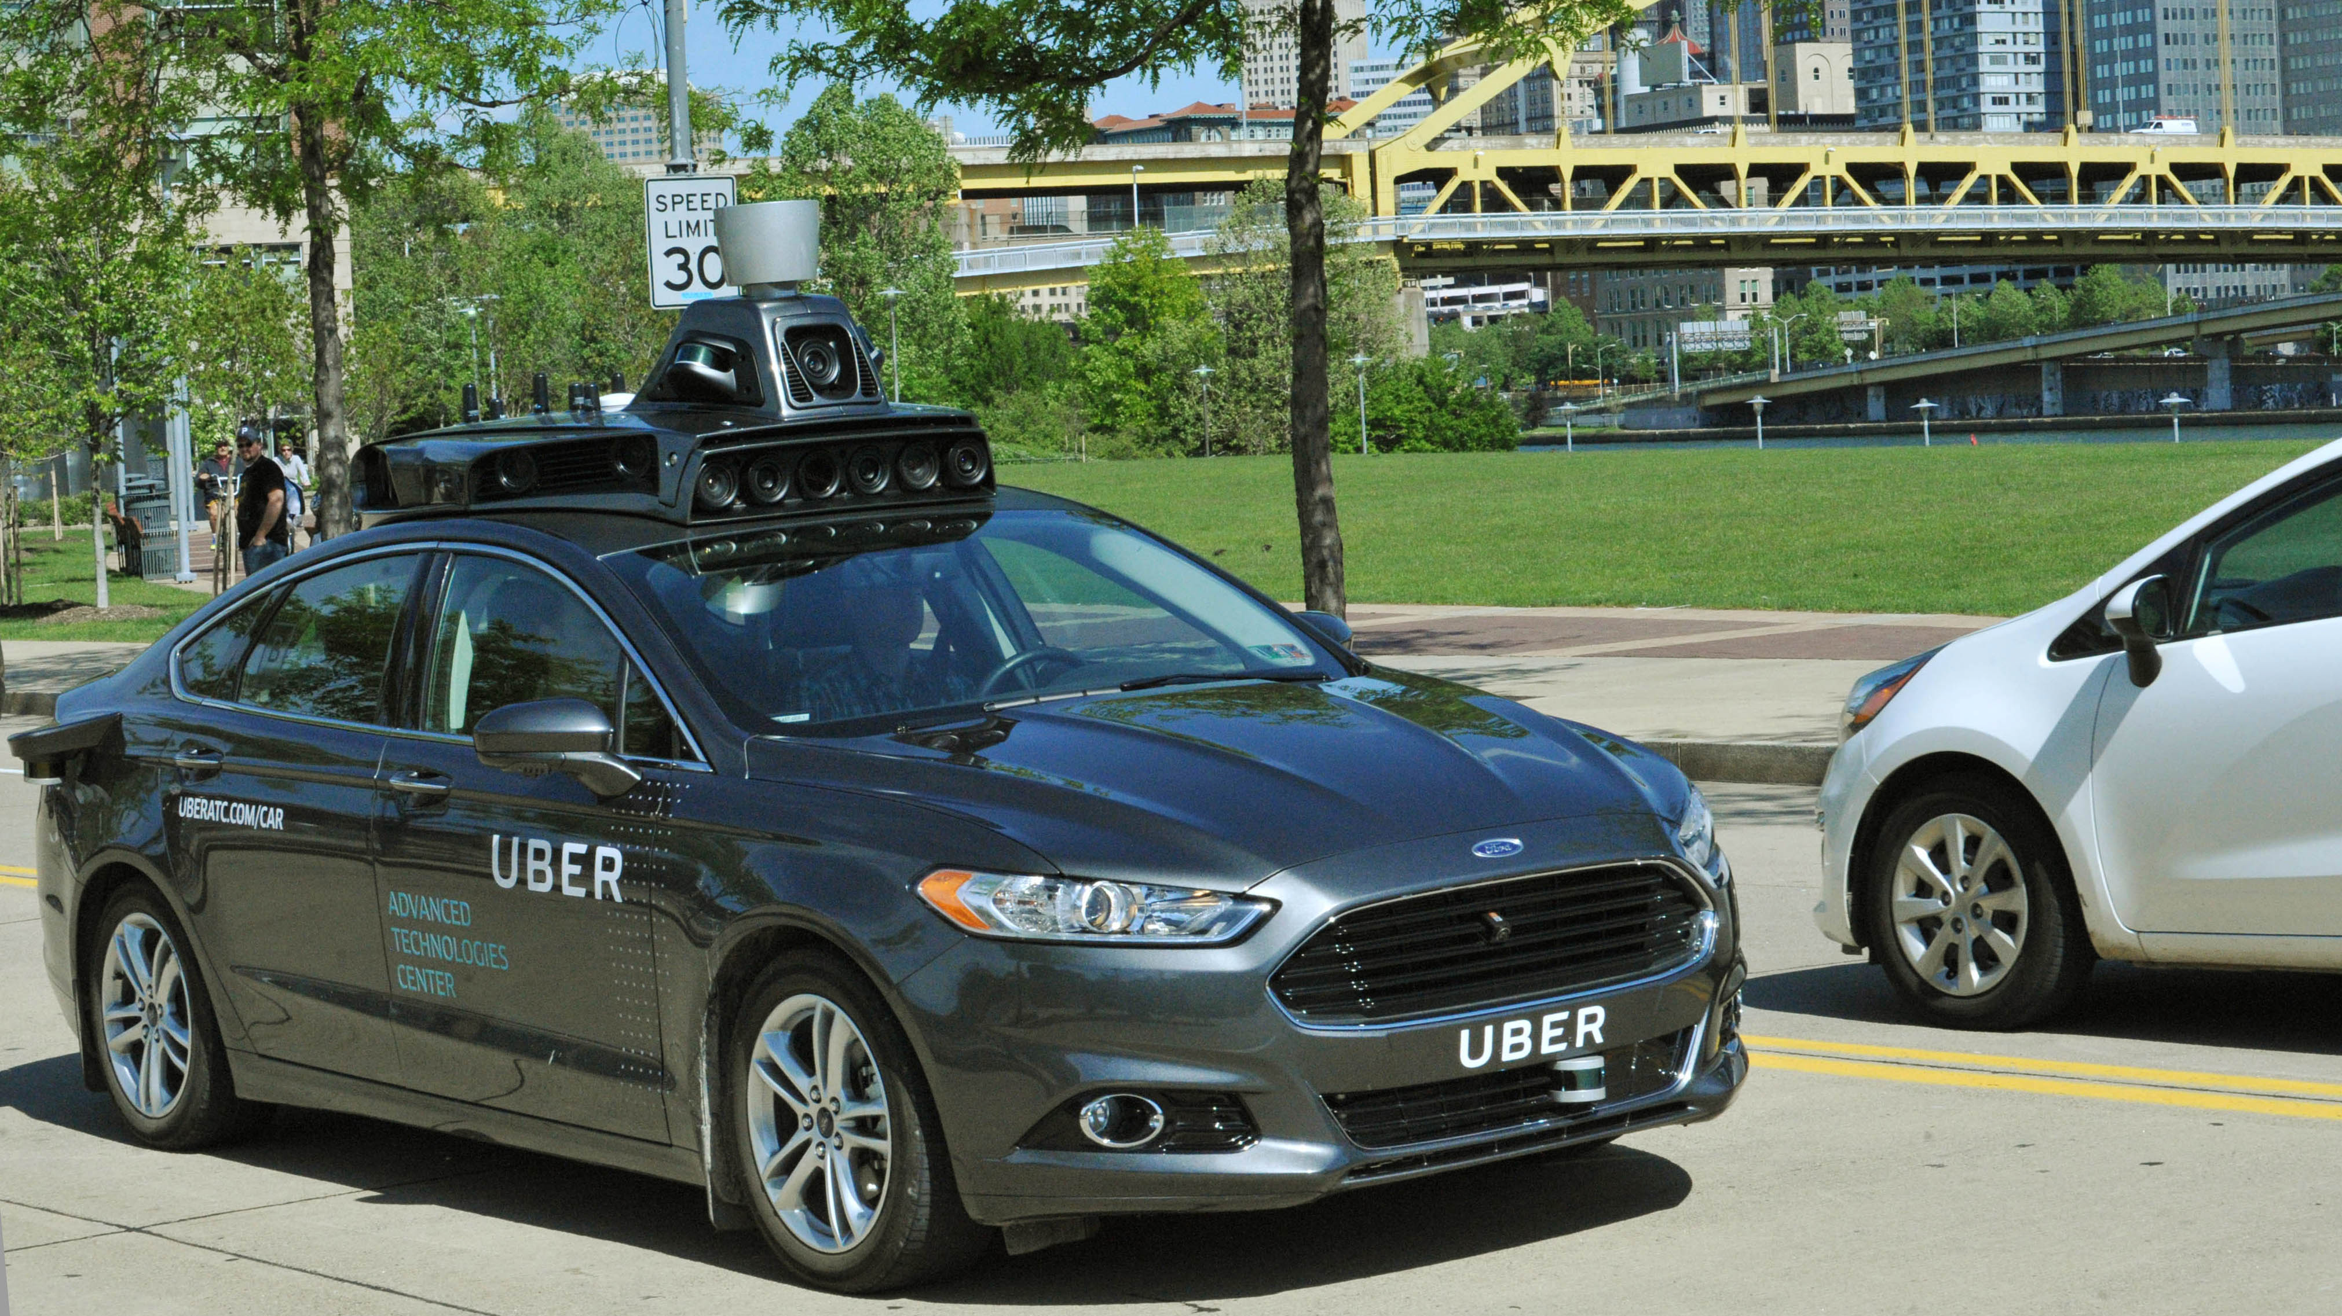
How a car drive itself

Slide 15
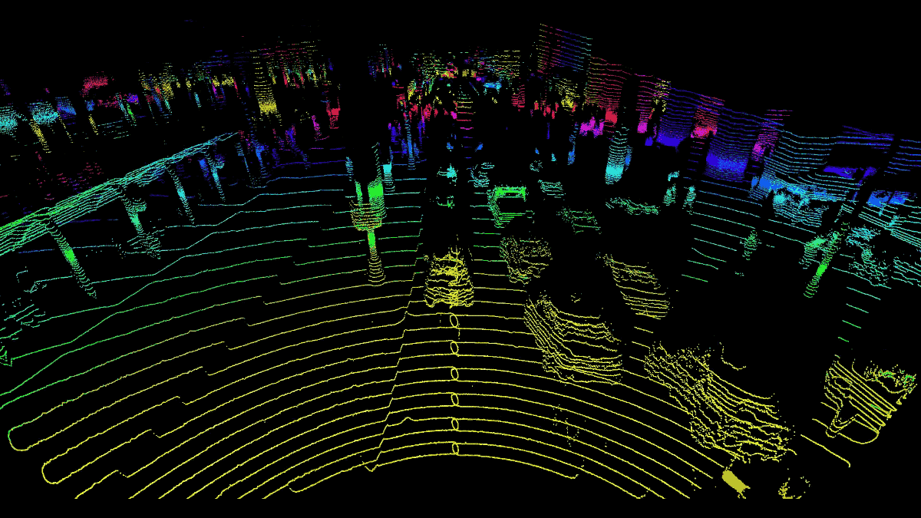

Lidar

Slide 16
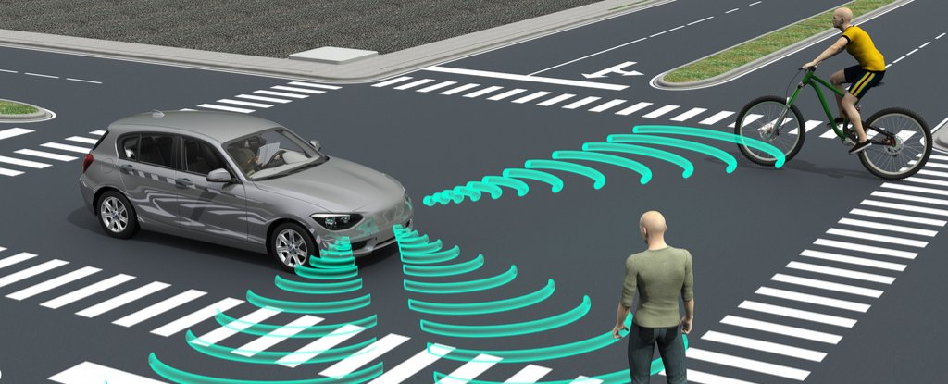

radar

Slide 17
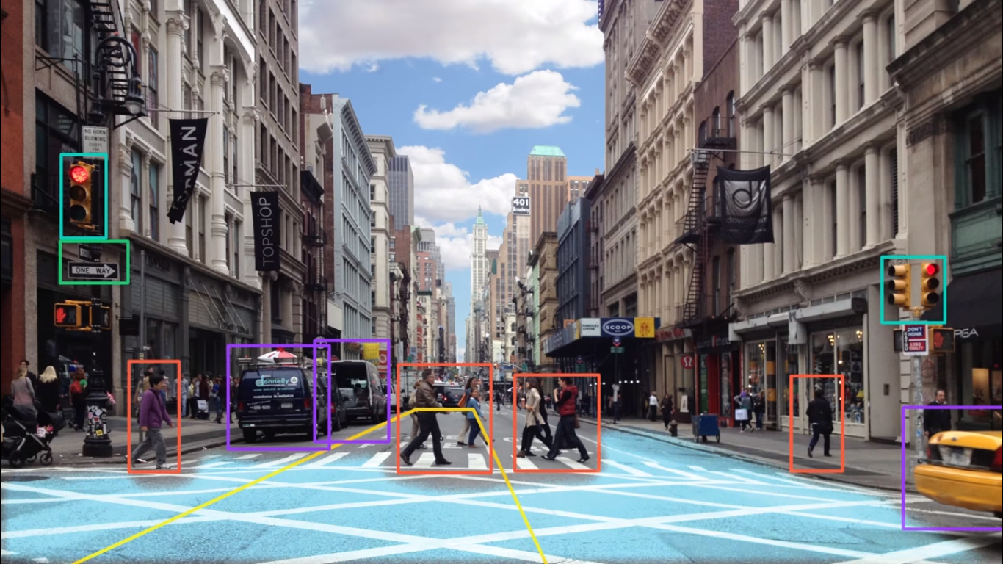
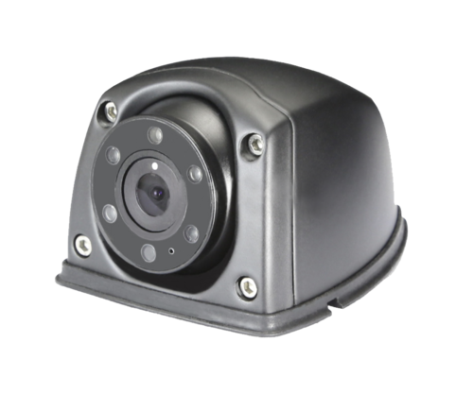
Camera

Slide 18
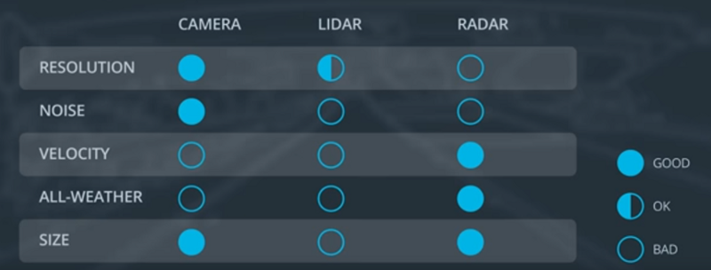
Sensor Comparison Chart

Slide 19
Autonomous Vehicle System Architecture
Sensors
Perception
Planning
Control
Camera
Radar
Lidar
GPS
Others
Detection
Route Planning
Behavior Planning
Localization
Trajectory Planning

Slide 20
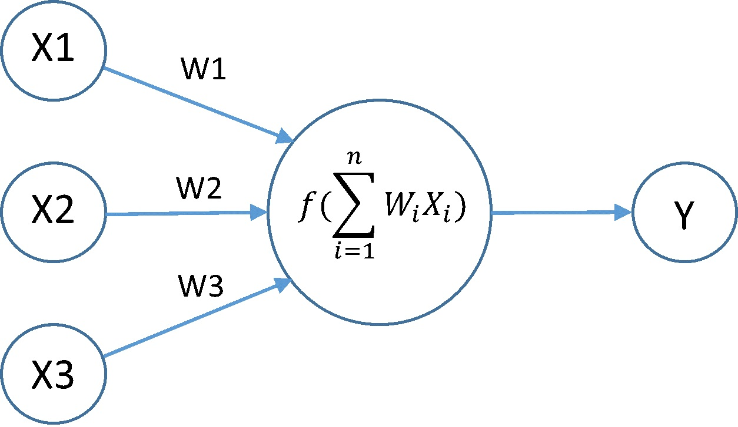
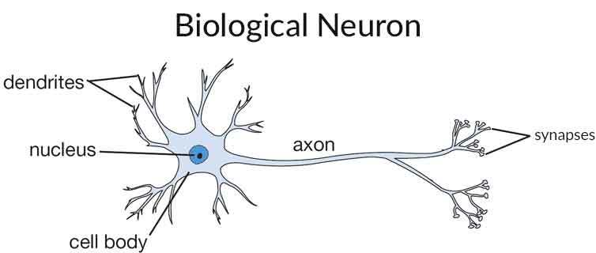
What does Artificial Intelligence (A.I.) mean ?
Artificial intelligence (AI) is an area of computer science that emphasizes the creation of intelligent machines that work and react like humans.

Slide 21
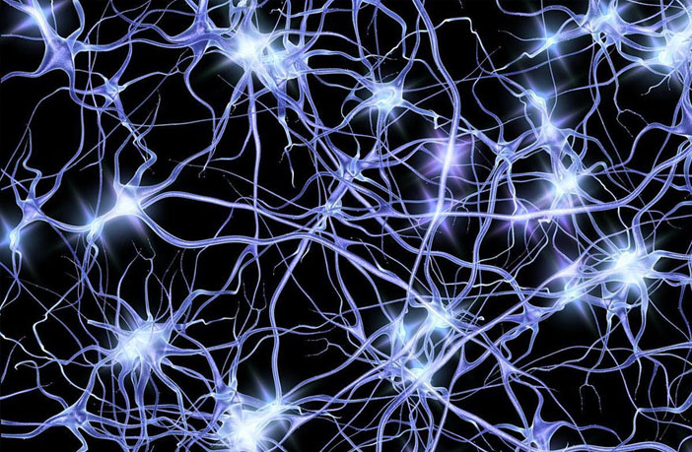
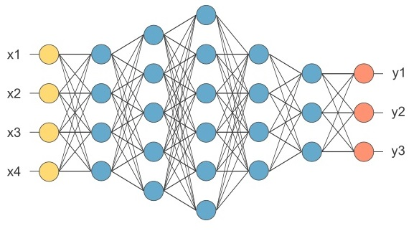
Neural Network
Neurons in Human Body
Neurons in Computer World

Slide 22
Pros and Cons
make our road safer
free up people’s time
improve mobility for everyone
expensive technology
computer malfunction could cause crashes
ethical problem

Slide 23
What Next ?

Slide 24
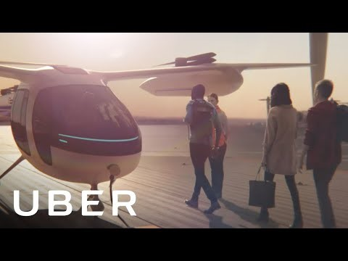

Slide 25
Any Questions ?

Slide 26
Thank-you

